Slide 1
INDR 100
INTRODUCTION TO INDUSTRIAL ENGINEERING
Linear Programming - 2

Slide 2
Agenda of the Day
Corner Point Solutions
Solving Linear Programming model with Corner Point Solution methodology: Example
Notes:
Class Exercise: Filsiz Boya Company
Bir önceki derste anlattım, buradan çıkarttım

Slide 3
Graphical Representation of the Problem
$$6 x_{1} + 10 x_{2} ≤480$$
$$8 x_{1 }+ 8 x_{2} ≤480$$
${ x}_{1} ≤40$
$$x_{1} , x_{2}≥ 0$$
x
2
Constraint 3
The set of all points
that satisfy all the
constraints of the
model is called a
Constraint 2
10 20 30 40 50 60 70
Feasible region
Constraint 1
50 60 70 80
^{x}₁
10
20
30
40

Slide 4
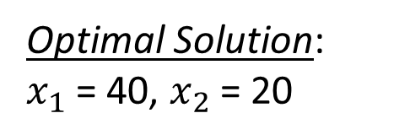

How can we find the optimal solution for a linear programming model?
Create an iso-value line from the objective function, by setting the objective function to any number.
An iso-value line is a line in which all points have the same objective function value
Graph the resulting line. By moving the line parallel, you will find the optimal solution (extreme point), if it exists.
x
2
iso-value line
Optimal Solution:
$x_{1}$ = 40, $x_{2}$ = 20
$$\operatorname{maximize}{3000}x_{1}+2000 x_{2}$$
10 20 30 40 50 60 70
50 60 70 80
^{x}₁
10
20
30
40
Notes:
${3000}x_{1}+2000 x_{2}$ = 6000 => $x_{1}$=0, $x_{2}$=3; $x_{1}$=2, $x_{2}$=0: draw the line that passes these two points.

Slide 5
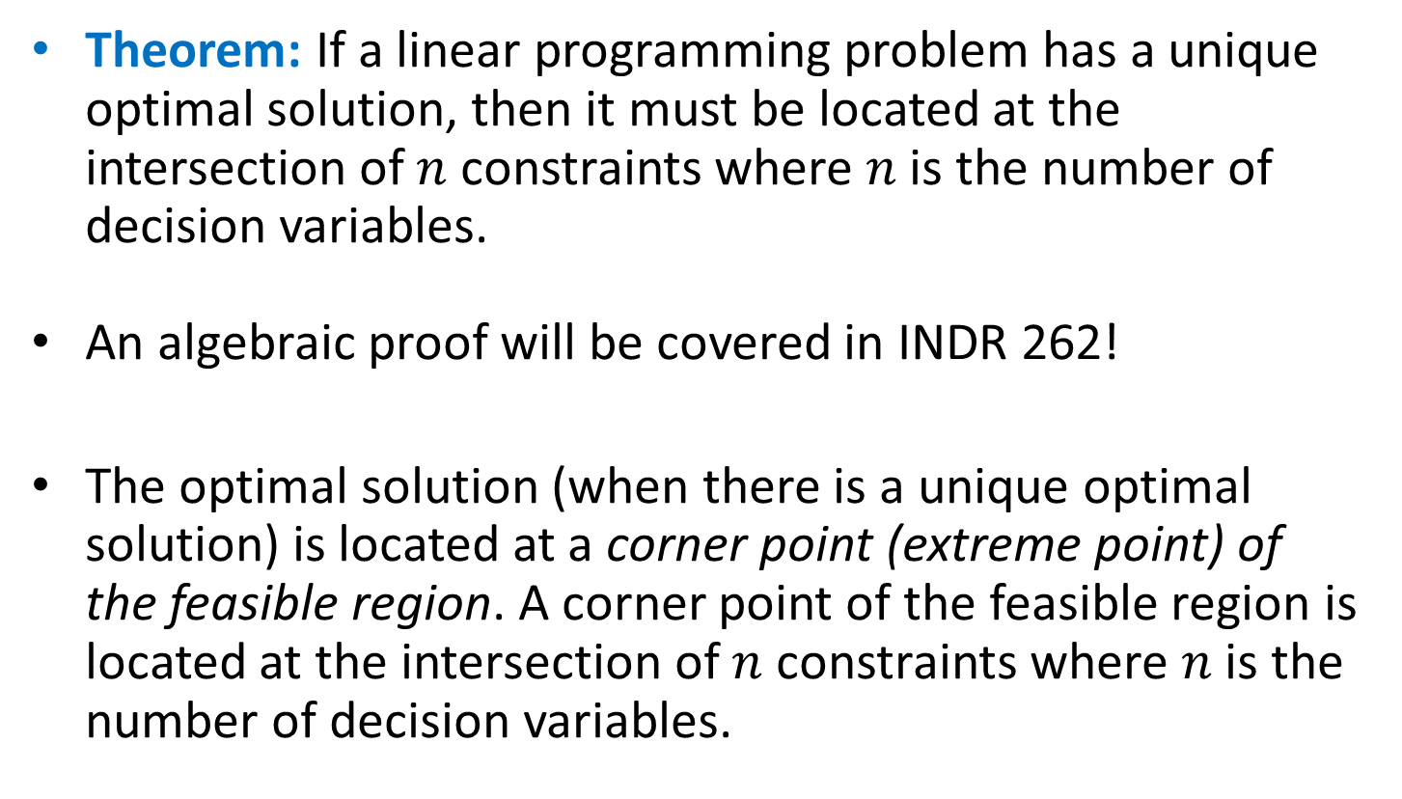
How to Find the Optimal Solution?
Theorem: If a linear programming problem has a unique optimal solution, then it must be located at the intersection of $n$ constraints where $n$ is the number of decision variables.
An algebraic proof will be covered in INDR 262!
The optimal solution (when there is a unique optimal solution) is located at a corner point (extreme point) of the feasible region. A corner point of the feasible region is located at the intersection of $n$ constraints where $n$ is the number of decision variables.

Slide 6
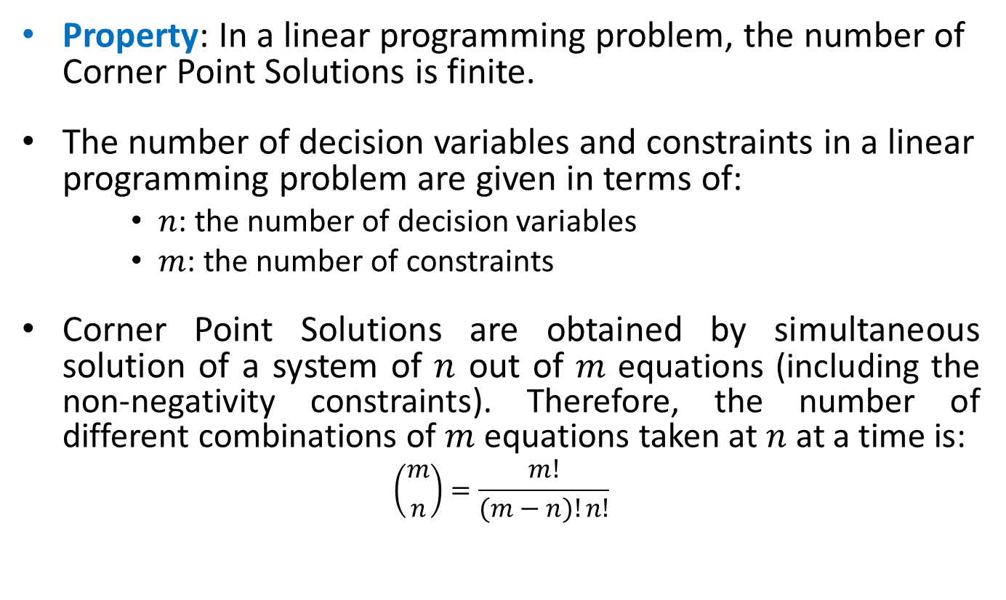
Corner Point Solutions
Property: In a linear programming problem, the number of Corner Point Solutions is finite.
The number of decision variables and constraints in a linear programming problem are given in terms of:
    $n$: the number of decision variables
    $m$: the number of constraints
Corner Point Solutions are obtained by simultaneous solution of a system of $n$ out of $m$ equations (including the non-negativity constraints). Therefore, the number of different combinations of $m$ equations taken at $n$ at a time is:
$$\left({m \atop n}\right)=\frac{m!}{(m−n)!n!}$$

Slide 7
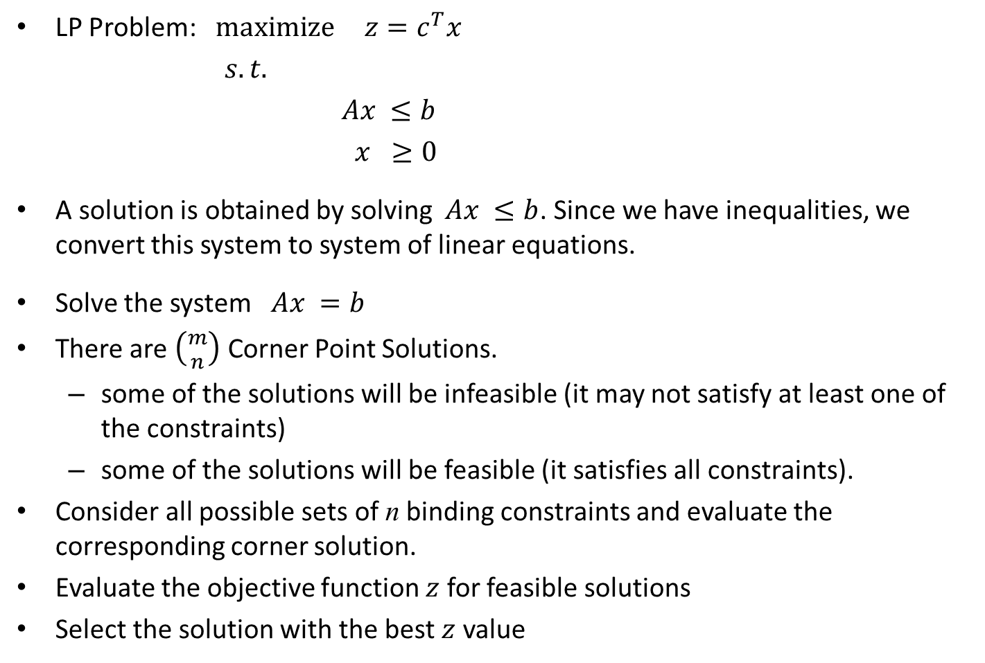
How to Find the Optimal Solution?
LP Problem: $\operatorname{maximize}{ z=c^{T}x}$
$s.t.$
$Ax ≤b$
$x ≥0$
A solution is obtained by solving $Ax ≤b$. Since we have inequalities, we convert this system to system of linear equations.
Solve the system $Ax =b$
There are $\left({m \atop n}\right)$ Corner Point Solutions.
  some of the solutions will be infeasible (it may not satisfy at least one of the constraints)
  some of the solutions will be feasible (it satisfies all constraints).
Consider all possible sets of n binding constraints and evaluate the corresponding corner solution.
Evaluate the objective function $z$ for feasible solutions
Select the solution with the best $z$ value

Slide 8
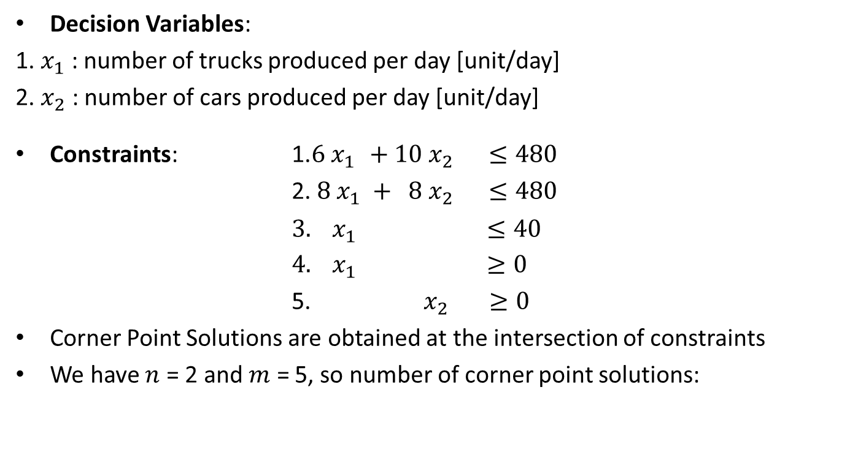
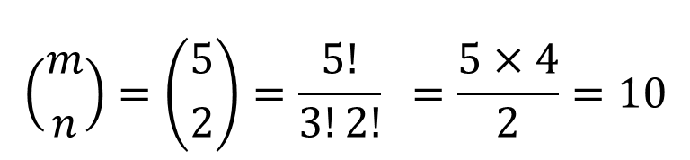
Example: Constraints
Decision Variables:
1. $x_{1}$ : number of trucks produced per day [unit/day]
2. $x_{2}$ : number of cars produced per day [unit/day]
Constraints: 1.$6 x_{1 }+10 x_{2} ≤480$
2. $8 x_{1} + 8 x_{2} ≤480$
${3. x}_{1} ≤40$
$4. x_{1} ≥0$
5. $x_{2} ≥0$
Corner Point Solutions are obtained at the intersection of constraints
We have $n$ = 2 and $m$ = 5, so number of corner point solutions:
$$\left({m \atop n}\right)=\left({5 \atop 2}\right)=\frac{5!}{3!2!} =\frac{5×4}{2}=10$$
Notes:
We are looking for combination because order is not important.

Slide 9
How to Find the Optimal Solution?
There is an alternative to the iso-value objective function approach with problems that have few constraints and a bounded feasible region.
First, find all the corner points, which will include extreme points.
Then, evaluate the objective function at the extreme points.
Next, find the optimal value and the optimal solution.

Slide 10

Example: Feasible Region
$maximize 3000 x_{1}+ 2000 x_{2}$
$6 x_{1}+ 10 x_{2}≤480$
$8 x_{1}+ 8 x_{2}≤480$
${ x}_{1} ≤40$
${ x}_{1} ≥0$
$x_{2}≥0$
x₂
CONSTRAINT 3
CONSTRAINT 2
Corner Point, which is an Extreme Point, that indicates a feasible solution
10 20 30 40 50 60 70
FEASIBLE REGION
(0,48)
Corner Point, which is infeasible
CONSTRAINT 1
(30,30)
(40,20)
(0,0)
(40,0)
x₁
10 20 30 40 50 60 70 80

Slide 11
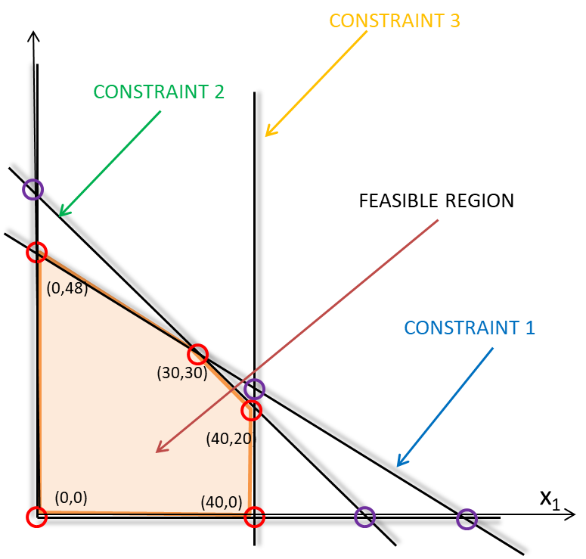
Example: Corner Point Solutions
We have the following corner point solutions:
1. constraint 1 and constraint 2
2. constraint 1 and constraint 3
3. constraint 1 and constraint 4
4. constraint 1 and constraint 5
5. constraint 2 and constraint 3
6. constraint 2 and constraint 4
7. constraint 2 and constraint 5
8. constraint 3 and constraint 4
9. constraint 3 and constraint 5
10. constraint 4 and constraint 5
6
3
1
2
5
7
4
10
9

Slide 12
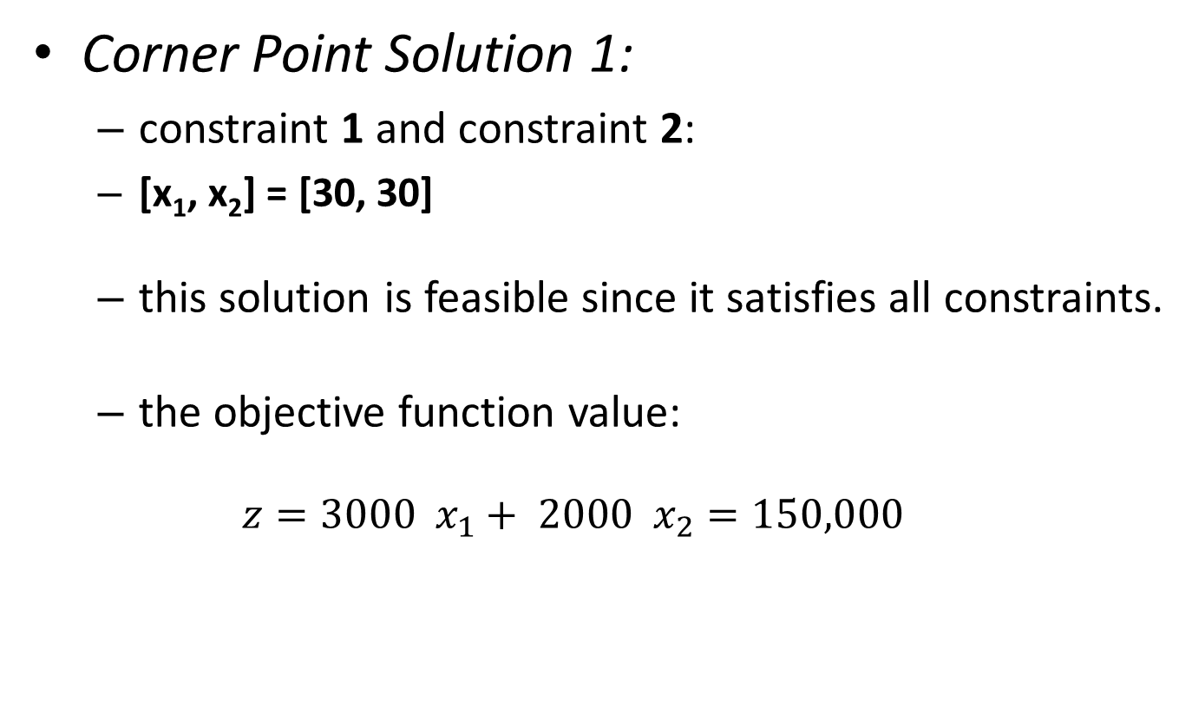
Example: Corner Point Solutions
Corner Point Solution 1:
  constraint 1 and constraint 2:
  [x₁, x₂] = [30, 30]
  this solution is feasible since it satisfies all constraints.
  the objective function value:
  $$z=3000 x_{1}+ 2000 x_{2}=150,000$$

Slide 13
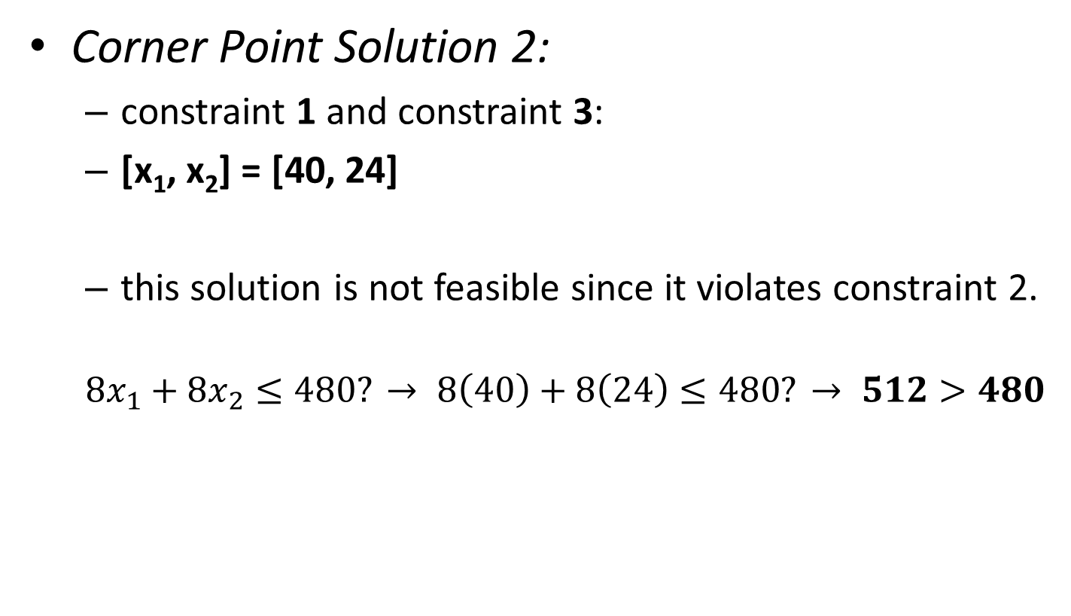
Example: Corner Point Solutions
Corner Point Solution 2:
  constraint 1 and constraint 3:
  [x₁, x₂] = [40, 24]
  this solution is not feasible since it violates constraint 2.
  $$8x_{1}+8x_{2}≤480? → 8\left(40\right)+8\left(24\right)≤480? → 512>480$$

Slide 14
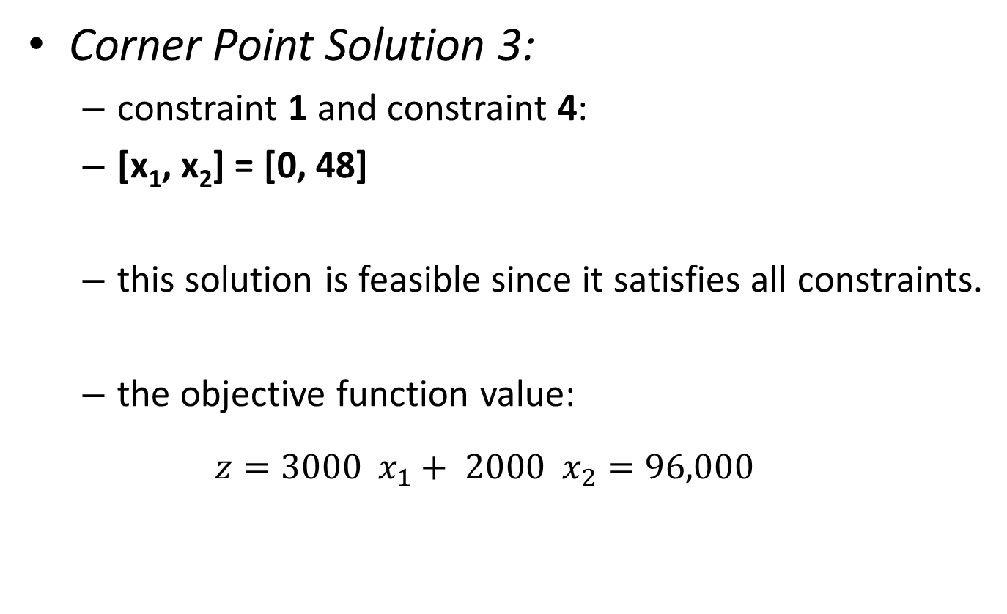
Example: Corner Point Solutions
Corner Point Solution 3:
  constraint 1 and constraint 4:
  [x₁, x₂] = [0, 48]
  this solution is feasible since it satisfies all constraints.
  the objective function value:
  $$z=3000 x_{1}+ 2000 x_{2}=96,000$$

Slide 15
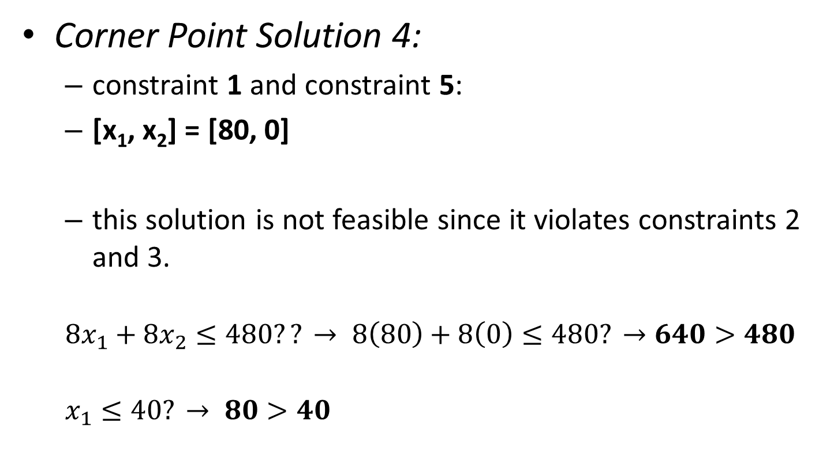
Example: Corner Point Solutions
Corner Point Solution 4:
  constraint 1 and constraint 5:
  [x₁, x₂] = [80, 0]
  this solution is not feasible since it violates constraints 2 and 3.
  $$8x_{1}+8x_{2}≤480?? → 8\left(80\right)+8\left(0\right)≤480? →640>480$$
  $$x_{1}≤40? → 80>40$$

Slide 16
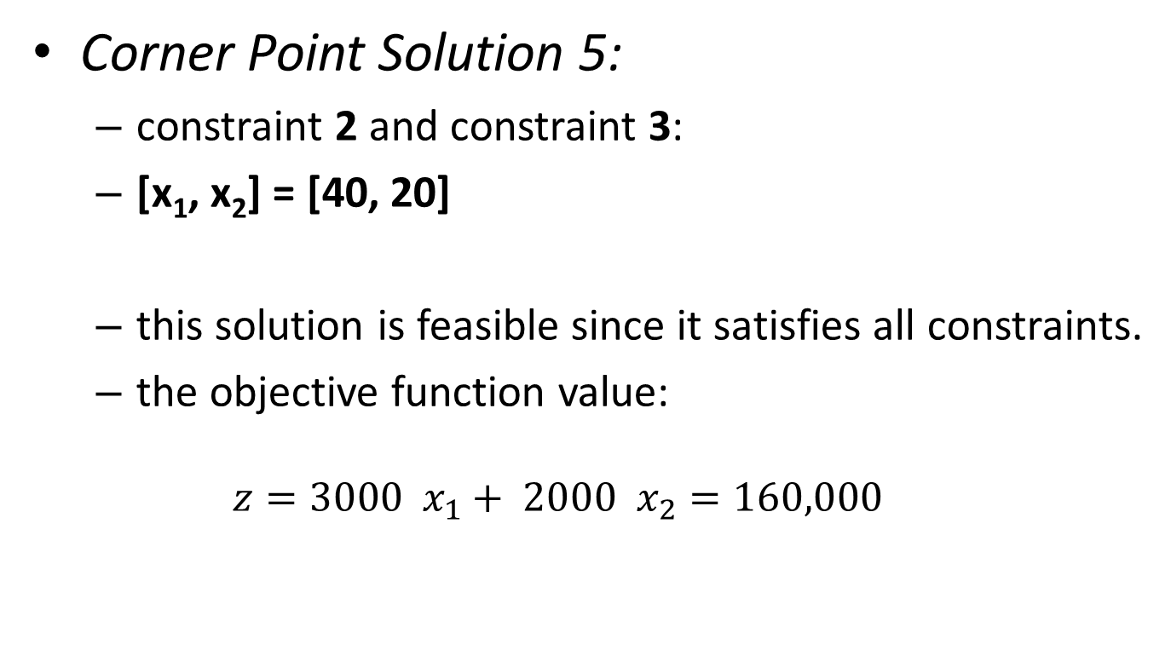
Example: Corner Point Solutions
Corner Point Solution 5:
  constraint 2 and constraint 3:
  [x₁, x₂] = [40, 20]
  this solution is feasible since it satisfies all constraints.
  the objective function value:
  $$z=3000 x_{1}+ 2000 x_{2}=160,000$$

Slide 17
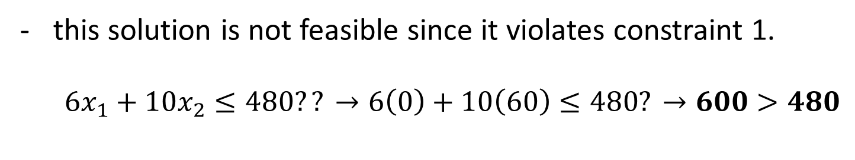
Example: Corner Point Solutions
Corner Point Solution 6:
  constraint 2 and constraint 4:
  [x₁, x₂] = [0, 60]
this solution is not feasible since it violates constraint 1.
  $$6x_{1}+10x_{2}≤480?? →6\left(0\right)+10\left(60\right)≤480? →600>480$$

Slide 18
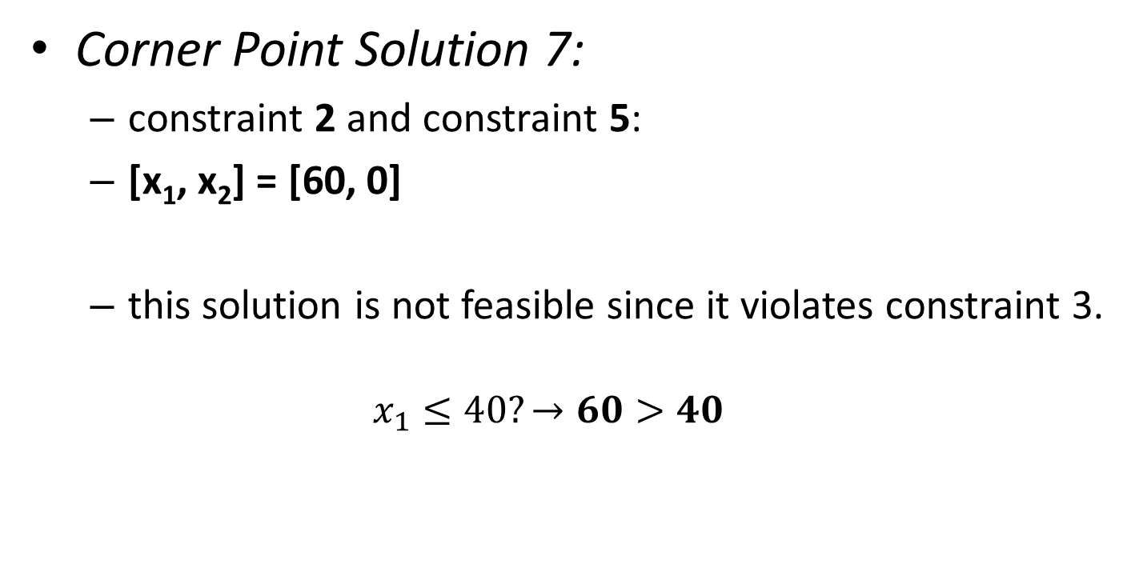
Example: Corner Point Solutions
Corner Point Solution 7:
  constraint 2 and constraint 5:
  [x₁, x₂] = [60, 0]
  this solution is not feasible since it violates constraint 3.
  $$x_{1}≤40?→60>40$$

Slide 19
Example: Corner Point Solutions
Corner Point Solution 8:
  constraint 3 and constraint 4:
  [x₁, x₂] = not defined
  There is no solution.

Slide 20
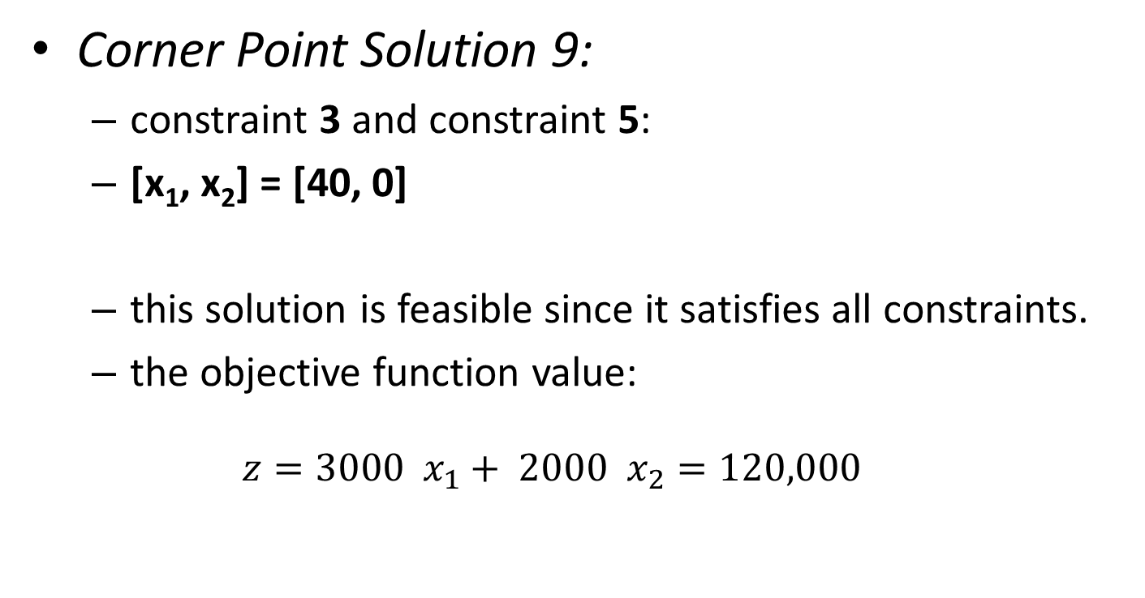
Example: Corner Point Solutions
Corner Point Solution 9:
  constraint 3 and constraint 5:
  [x₁, x₂] = [40, 0]
  this solution is feasible since it satisfies all constraints.
  the objective function value:
  $$z=3000 x_{1}+ 2000 x_{2}=120,000$$

Slide 21
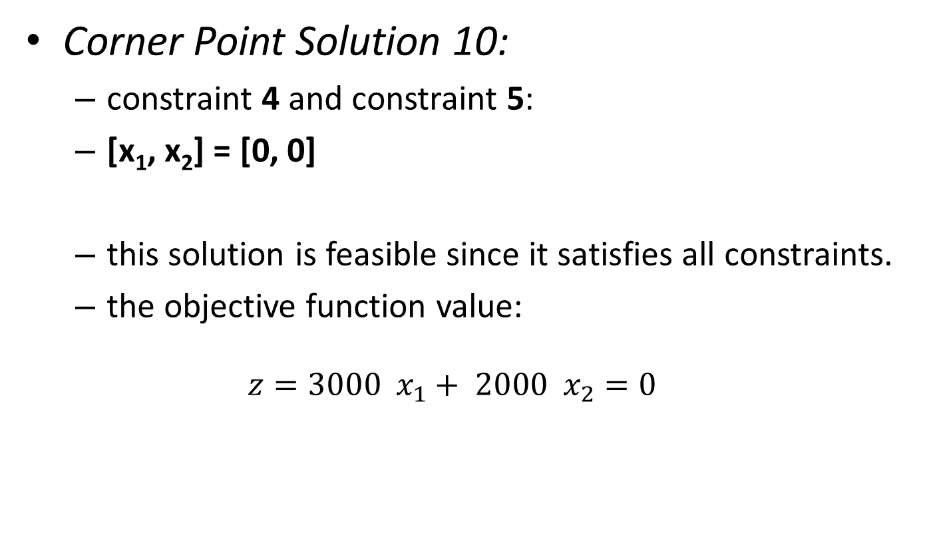
Example: Corner Point Solutions
Corner Point Solution 10:
  constraint 4 and constraint 5:
  [x₁, x₂] = [0, 0]
  this solution is feasible since it satisfies all constraints.
  the objective function value:
  $$z=3000 x_{1}+ 2000 x_{2}=0$$

Slide 22
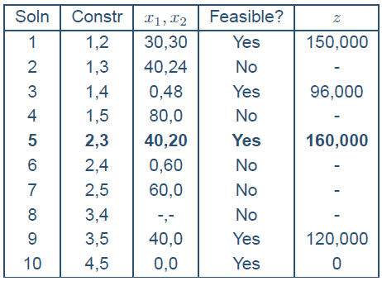
Example: Summary of Solutions

Slide 23

Example:
Summary of Solutions
$maximize 3000 x_{1}+ 2000 x_{2}$
$6 x_{1}+ 10 x_{2}≤480$
$8 x_{1}+ 8 x_{2}≤480$
${ x}_{1} ≤40$
${ x}_{1} ≥0$
$x_{2}≥0$
x₂
CONSTRAINT 3
CONSTRAINT 2
FEASIBLE REGION
(0,48)
CONSTRAINT 1
(30,30)
(40,20)
(0,0)
(40,0)
x₁
10 20 30 40 50 60 70 80

Slide 24
Example: Paint Production
A paint company produces two types of paints from two raw materials.
Paint 1 requires 6 tons of raw material 1 per ton.
Paint 1 requires 1 ton of raw material 2 per ton.
Paint 2 requires 4 tons of raw material 1 per ton.
Paint 2 requires 2 tons of raw material 2 per ton.
A total of 24 tons of raw material 1 is available.
A total of 6 tons of raw material 2 is available.
Maximum daily sales for paint 2 is 2 tons per day.
The daily sales for paint 2 cannot exceed that of paint 1 by more than 1 ton.
Each ton of paint 1 contributes 5,000 TL to profit.
Each ton of paint 2 contributes 4,000 TL to profit.

Slide 25
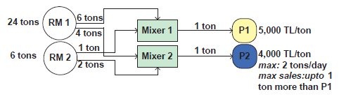
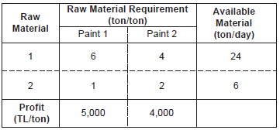
Example: Process Diagram and Data
Process Flow Diagram:
Problem Data:

Slide 26
Guidelines for Model Development
Write a verbal description of the objective
Write a verbal description of each constraints
Define the decision variables
Express the objective in terms of the decision variables
Express the constraints in terms of the decision variables

Slide 27
Example: Objective
What could be a proper objective for this problem?
Review the facts:
  the factory produces two types of paints,
  two types of ingredients are required for production,
  the factory exists (survives) by making profit.
Objective: maximize the total daily profit.

Slide 28
Example: Constraints
Raw Material 1:
  paint 1 and paint 2 requires raw material 1
  the maximum daily availability of raw material 1 is limited to 24 [ton/day]
Constraint 1: We can use a maximum of 24 tons of raw material 1.
Raw Material 2:
  paint 1 and paint 2 requires raw material 2
  the maximum daily availability of raw material 2 is limited to 6 [ton/day]
Constraint 2: We can use a maximum of 6 tons of raw material 2.

Slide 29
Example: Constraints
Sales Limit on Paint 2:
  sales of paint 2 to is limited to 2 tons a day
Constraint 3: It is not possible to sell more than 2 tons of paint 2 a day.
Sales Limit on Paint 2 wrt the Sales of Paint 1:
  sales of paint 2 cannot exceed that of paint 1 by 1 ton a day
Constraint 4: The sales of paint 2 cannot exceed that of paint 1 by more than 1 ton.

Slide 30
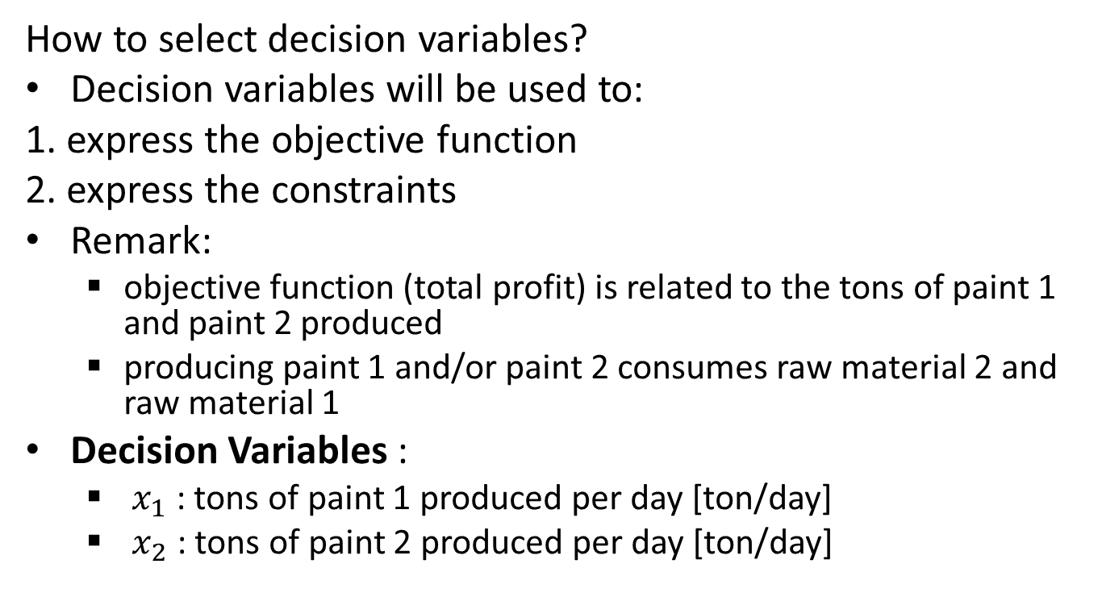
Example: Decision Variables
How to select decision variables?
Decision variables will be used to:
1. express the objective function
2. express the constraints
Remark:
  objective function (total profit) is related to the tons of paint 1 and paint 2 produced
  producing paint 1 and/or paint 2 consumes raw material 2 and raw material 1
Decision Variables :
  $x_{1}$ : tons of paint 1 produced per day [ton/day]
  $x_{2}$ : tons of paint 2 produced per day [ton/day]

Slide 31
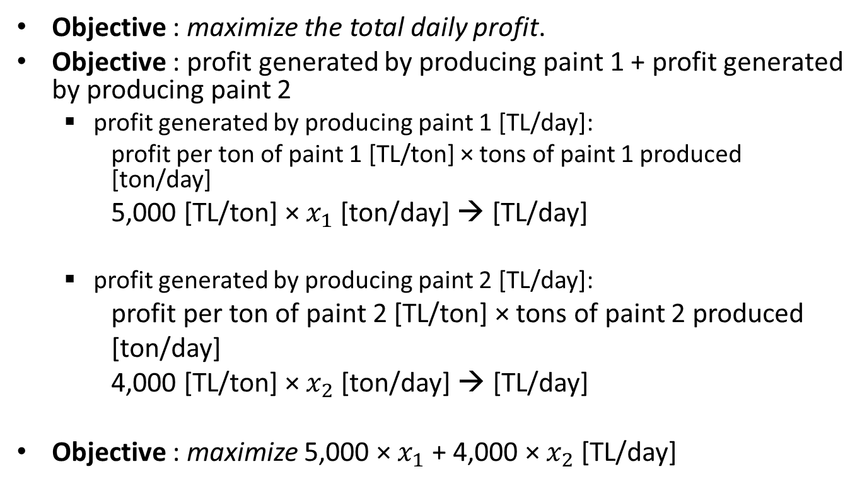
Example: Objective Function Formulation
Objective : maximize the total daily profit.
Objective : profit generated by producing paint 1 + profit generated by producing paint 2
  profit generated by producing paint 1 [TL/day]:
  profit per ton of paint 1 [TL/ton] × tons of paint 1 produced [ton/day]
5,000 [TL/ton] × $x_{1}$ [ton/day] → [TL/day]
  profit generated by producing paint 2 [TL/day]:
profit per ton of paint 2 [TL/ton] × tons of paint 2 produced
[ton/day]
4,000 [TL/ton] × $x_{2}$ [ton/day] → [TL/day]
Objective : maximize 5,000 × $x_{1}$ + 4,000 × $x_{2}$ [TL/day]

Slide 32
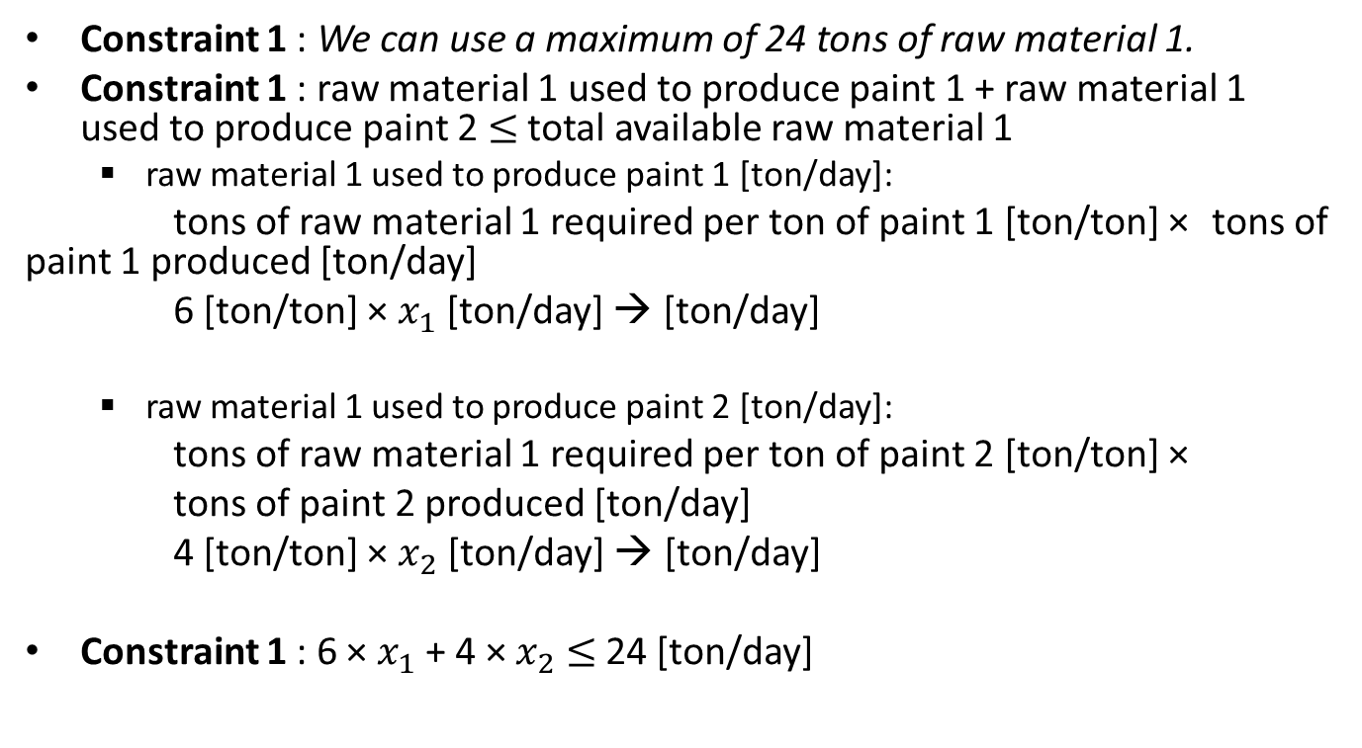
Example: Constraint Formulation
Constraint 1 : We can use a maximum of 24 tons of raw material 1.
Constraint 1 : raw material 1 used to produce paint 1 + raw material 1 used to produce paint 2 $≤$total available raw material 1
  raw material 1 used to produce paint 1 [ton/day]:
tons of raw material 1 required per ton of paint 1 [ton/ton] × tons of paint 1 produced [ton/day]
6 [ton/ton] × $x_{1}$ [ton/day] → [ton/day]
  raw material 1 used to produce paint 2 [ton/day]:
tons of raw material 1 required per ton of paint 2 [ton/ton] ×
tons of paint 2 produced [ton/day]
4 [ton/ton] × $x_{2}$ [ton/day] → [ton/day]
Constraint 1 : 6 × $x_{1}$ + 4 × $x_{2}$ $≤$ 24 [ton/day]

Slide 33
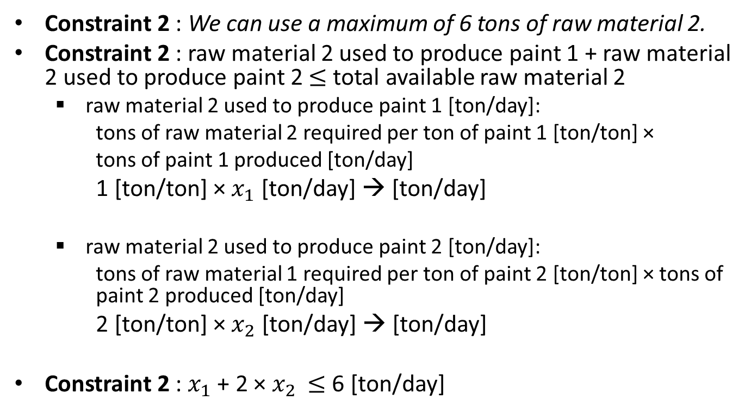
Example: Constraint Formulation
Constraint 2 : We can use a maximum of 6 tons of raw material 2.
Constraint 2 : raw material 2 used to produce paint 1 + raw material 2 used to produce paint 2 $≤$total available raw material 2
  raw material 2 used to produce paint 1 [ton/day]:
  tons of raw material 2 required per ton of paint 1 [ton/ton] ×
  tons of paint 1 produced [ton/day]
1 [ton/ton] × $x_{1}$ [ton/day] → [ton/day]
  raw material 2 used to produce paint 2 [ton/day]:
  tons of raw material 1 required per ton of paint 2 [ton/ton] × tons of paint 2 produced [ton/day]
2 [ton/ton] × $x_{2}$ [ton/day] → [ton/day]
Constraint 2 : $x_{1}$ + 2 × $x_{2}$ $≤$6 [ton/day]

Slide 34
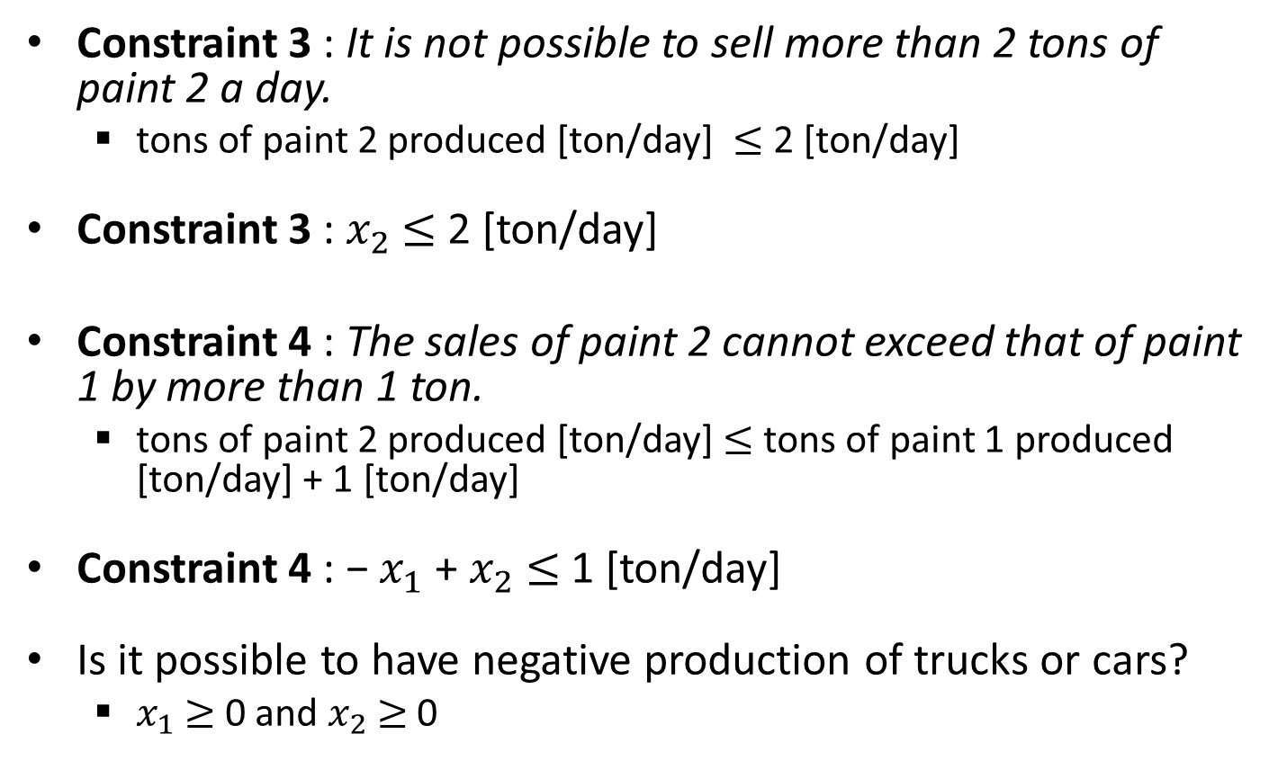
Example: Constraint Formulation
Constraint 3 : It is not possible to sell more than 2 tons of paint 2 a day.
  tons of paint 2 produced [ton/day] $≤$2 [ton/day]
Constraint 3 : $x_{2}$ $≤$ 2 [ton/day]
Constraint 4 : The sales of paint 2 cannot exceed that of paint 1 by more than 1 ton.
  tons of paint 2 produced [ton/day] $≤$ tons of paint 1 produced [ton/day] + 1 [ton/day]
Constraint 4 : − $x_{1}$ + $x_{2}$ $≤$ 1 [ton/day]
Is it possible to have negative production of trucks or cars?
  $x_{1}$ $≥$ 0 and $x_{2}$ $≥$ 0

Slide 35
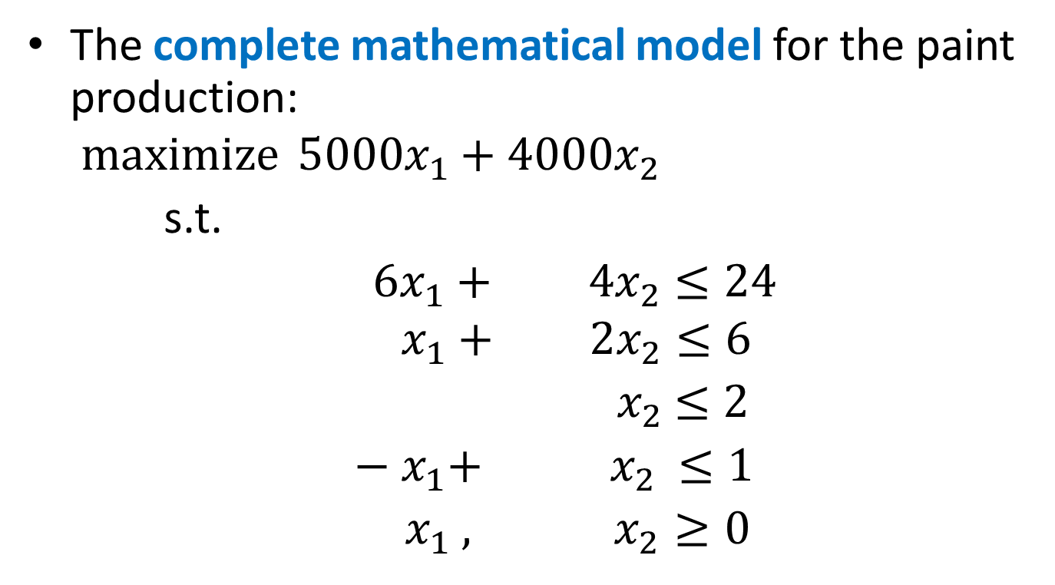
Example: Complete Model
The complete mathematical model for the paint production:
$$\operatorname{maximize}{5000x_{1}+4000x_{2}}$$
s.t.
$6x_{1}+ 4x_{2}≤24$
$${ x}_{1} + 2x_{2}≤6$$
${ x}_{2} ≤2$
$− x_{1}+ { x}_{2} ≤1$
$x_{1} ,{ x}_{2} ≥0$

Slide 36
Example: Feasible Region
x₂
1 2 3 4 5 6
FEASIBLE REGION
(1,2)
(2,2)
(3,1.5)
(0,1)
(0,0)
(4,0)
x₁
1 2 3 4 5 6

Slide 37
Class Exercise
How many corner points are there?

Slide 38
Example: Corner Point Solutions
We have the following corner point solutions:
1. constraint 1 and constraint 2
2. constraint 1 and constraint 3
3. constraint 1 and constraint 4
4. constraint 1 and constraint 5
5. constraint 1 and constraint 6
6. constraint 2 and constraint 3
7. constraint 2 and constraint 4
8. constraint 2 and constraint 5
9. constraint 2 and constraint 6
10. constraint 3 and constraint 4
11. constraint 3 and constraint 5
12. constraint 3 and constraint 6
13. constraint 4 and constraint 5
14. constraint 4 and constraint 6
15. constraint 5 and constraint 6
From the graphical representation,
we know that 6 of these corner
points are feasible solutions.
Which ones are feasible?

Slide 39
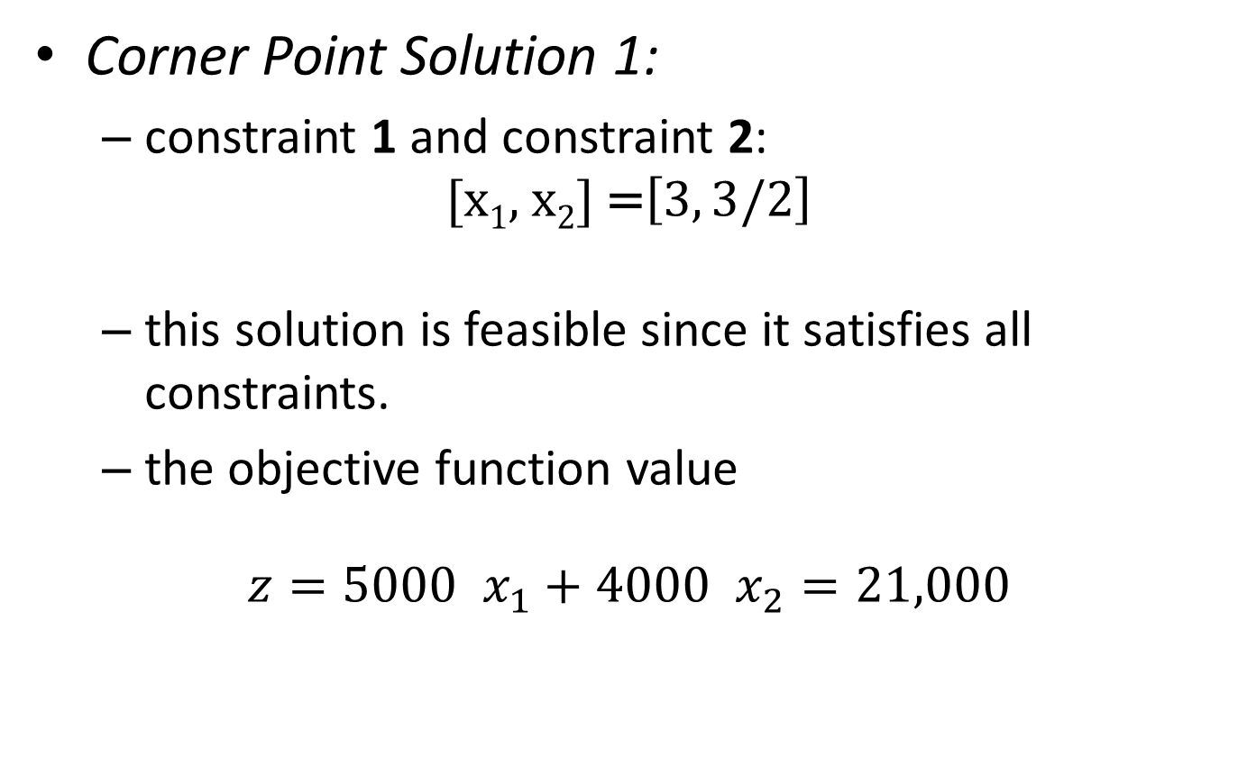
Example: Corner Point Solutions
Corner Point Solution 1:
  constraint 1 and constraint 2:
  $$\text{[}\text{x}\text{1}\text{, }\text{x}\text{2}\text{] }\text{=}\left[3, 3/2\right]$$
  this solution is feasible since it satisfies all constraints.
  the objective function value
$$z=5000 x_{1}+4000 x_{2}=21,000$$

Slide 40
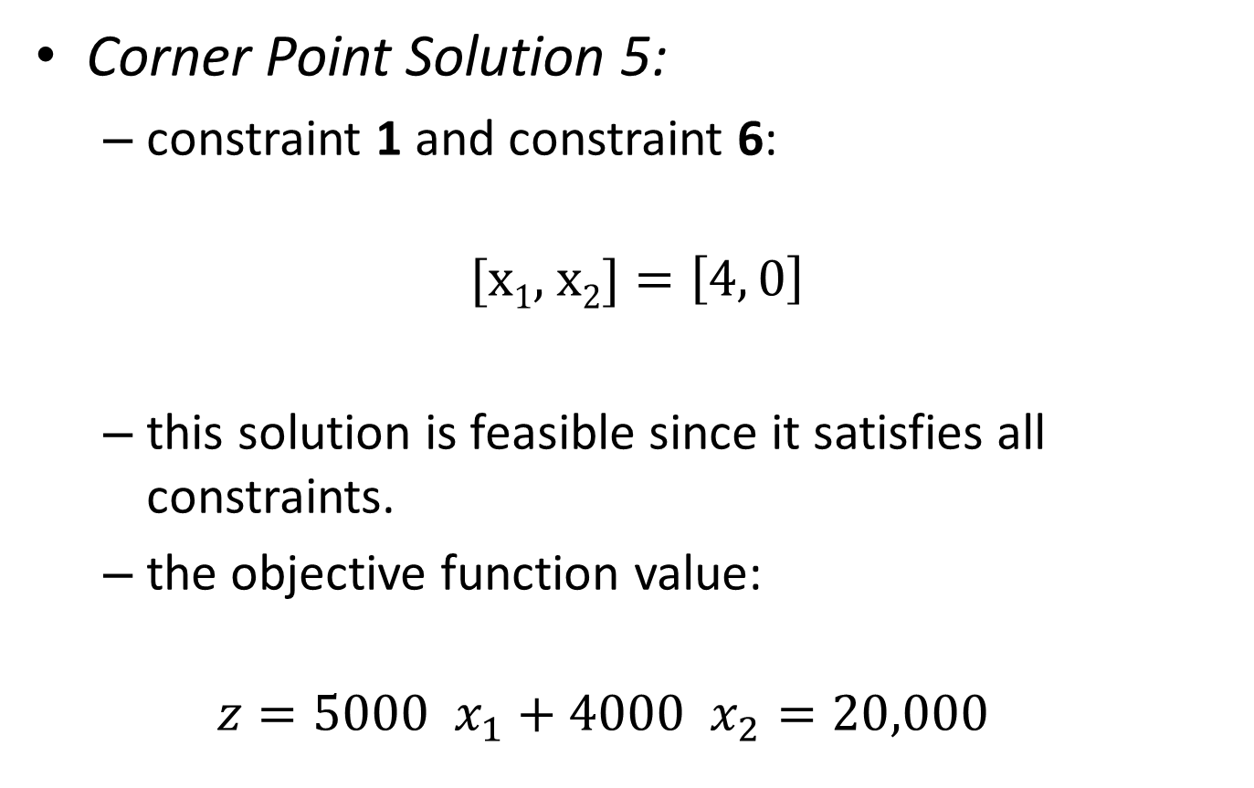
Example: Corner Point Solutions
Corner Point Solution 5:
  constraint 1 and constraint 6:
  $$\text{[}\text{x}\text{1}\text{, }\text{x}\text{2}\text{]}=\left[4, 0\right]$$
  this solution is feasible since it satisfies all constraints.
  the objective function value:
  $$z=5000 x_{1}+4000 x_{2}=20,000$$

Slide 41
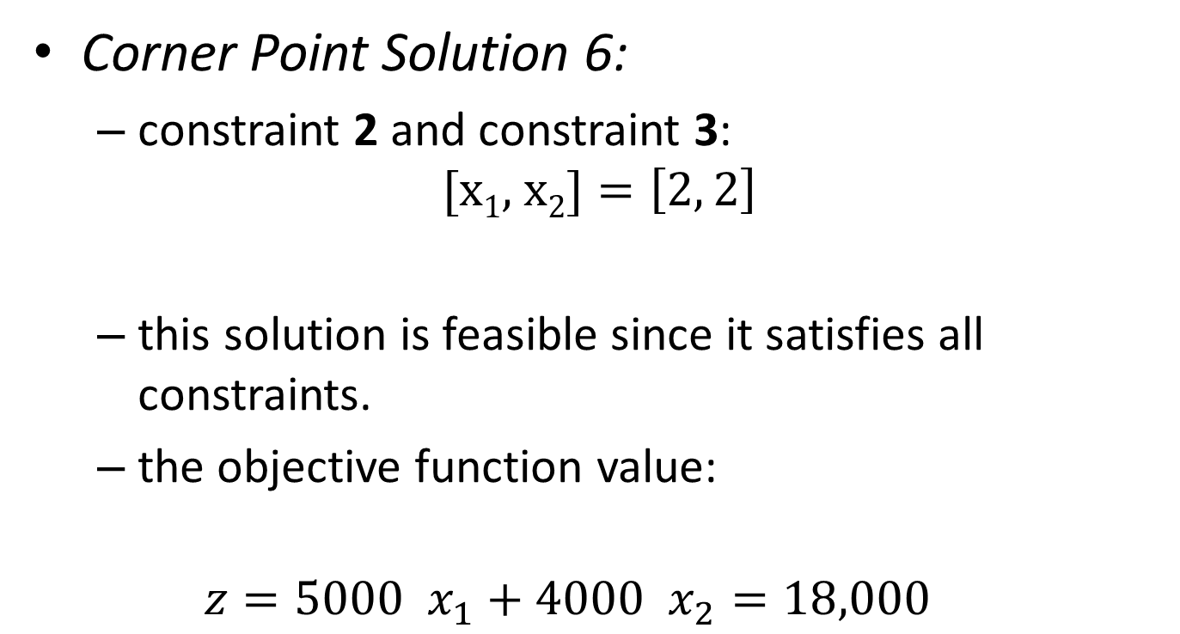
Example: Corner Point Solutions
Corner Point Solution 6:
  constraint 2 and constraint 3:
  $$\text{[}\text{x}\text{1}\text{, }\text{x}\text{2}\text{]}=\left[2, 2\right]$$
  this solution is feasible since it satisfies all constraints.
  the objective function value:
  $$z=5000 x_{1}+4000 x_{2}=18,000$$

Slide 42
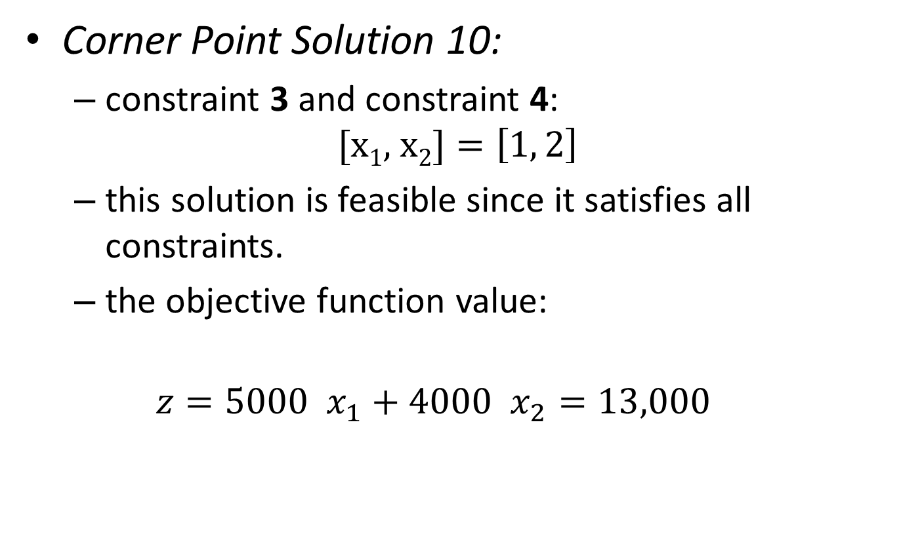
Example: Corner Point Solutions
Corner Point Solution 10:
  constraint 3 and constraint 4:
  $$\text{[}\text{x}\text{1}\text{, }\text{x}\text{2}\text{]}=\left[1, 2\right]$$
  this solution is feasible since it satisfies all constraints.
  the objective function value:
  $$z=5000 x_{1}+4000 x_{2}=13,000$$

Slide 43
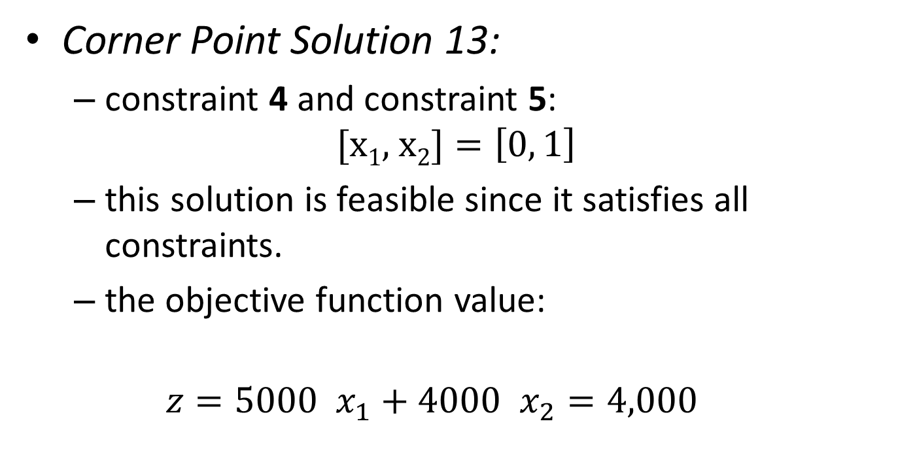
Example: Corner Point Solutions
Corner Point Solution 13:
  constraint 4 and constraint 5:
  $$\text{[}\text{x}\text{1}\text{, }\text{x}\text{2}\text{]}=\left[0, 1\right]$$
  this solution is feasible since it satisfies all constraints.
  the objective function value:
  $$z=5000 x_{1}+4000 x_{2}=4,000$$

Slide 44
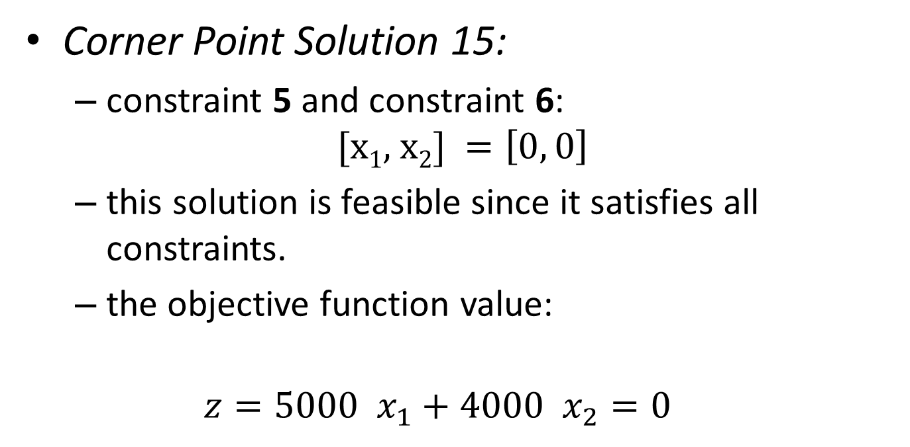
Example: Corner Point Solutions
Corner Point Solution 15:
  constraint 5 and constraint 6:
  $$\text{[}\text{x}\text{1}\text{, }\text{x}\text{2}\text{] }=\left[0, 0\right]$$
  this solution is feasible since it satisfies all constraints.
  the objective function value:
  $$z=5000 x_{1}+4000 x_{2}=0$$

Slide 45
Class Exercise
Which solution is optimal?

Slide 46
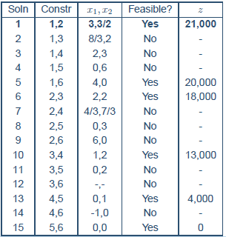
Example: Summary of Solutions

